Slide 1
The TEASA Witness
A platform for evangelical unity and mission
www.teasa.org

Slide 2
A brief history
1974 | The predecessor to TEASA, named Evangelical Fellowship of South Africa was formed, to unite evangelicals.
1986 | Black evangelicals separate from white evangelicals to form Concerned Evangelicals.
1994 | South Africa holds its first multi racial, democratic elections laying the ground for normalising race relations in South Africa.
1995 | Black and white evangelical church leaders establish TEASA as a platform for unity and witness.
2007 | TEASA goes into alliances with others to form Marriage Alliance of South Africa, opposing same sex marriages.
2010/ TEASA co- hosts conference of Lausanne Congress on World Evangelisation in Cape Town.
Collaborates in launching a Sports ministry collation to preach the gospel during World Cup.
2013/ Collaborates with the South African Council of Churches, African Enterprise and others to set up the South African Christian Leadership Initiative (SACLI).
Through SACLI, collaborated with others in Save South Africa to confront State Capture.
2017 Hosts Evangelical Leaders from Palestine. Advocacy support for Palestinians begins.
2020: Updates its Constitution & Celebrates 25th Anniversary.
2021 Hosts Evangelical Leaders from West Papua. Advocacy to support West Papua begins
Works with Civil Society ( Defend our Democracy) to campaign for implementation of Zondo Commission recommendations.
2024 Collaborates with others to advocate against the ideologizing of

Slide 3
The Shape of the Evangelical movement in SA today
Positively
Negatively
Youthful, vibrant and growing.
social concerns & public issues are being addressed
prayer mobilisation is unprecedented,
church renewal is happening, with different spiritual gifts in operation.
Shallow discipleship with accompanying ethical scandals,
cultic tendencies that undermine evangelical integrity and witness,
Weak evangelical brand
weak institutions.
Competing mushrooming unity efforts

Slide 4
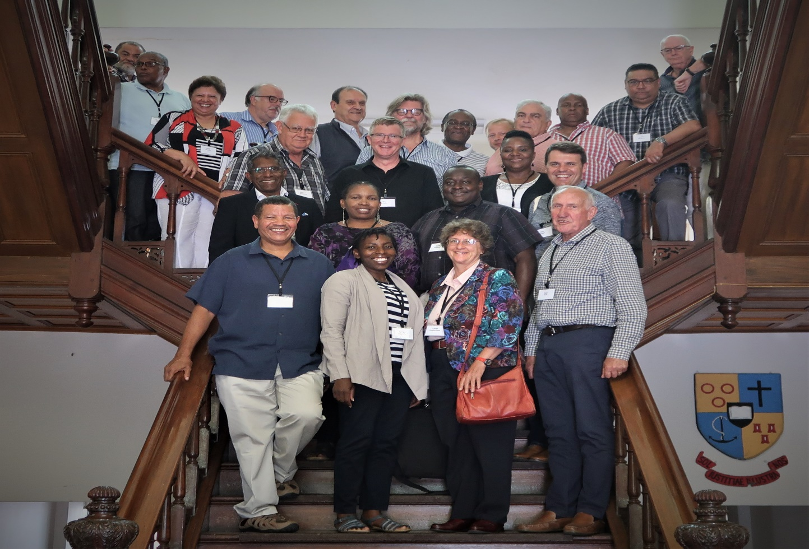
TEASA Growth Strategy
Connecting
Capacitating
Communicating
TEASA Theological Consultation Participant at Stellenbosch University

Slide 5
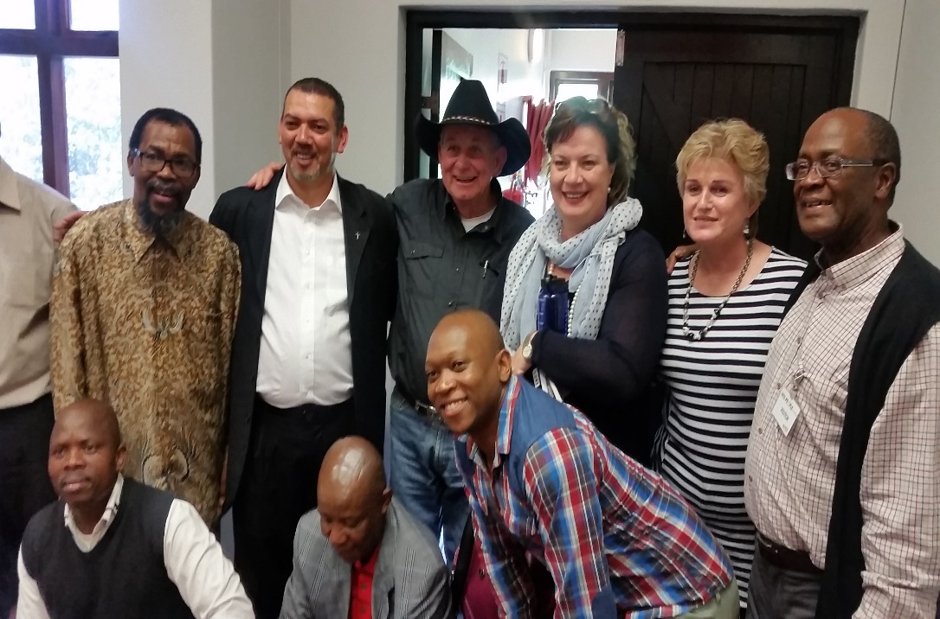
Connecting in Unity
Connecting churches in mission
Connecting Evangelists, Activists, ecumenists, Pastors and pastors

Slide 6
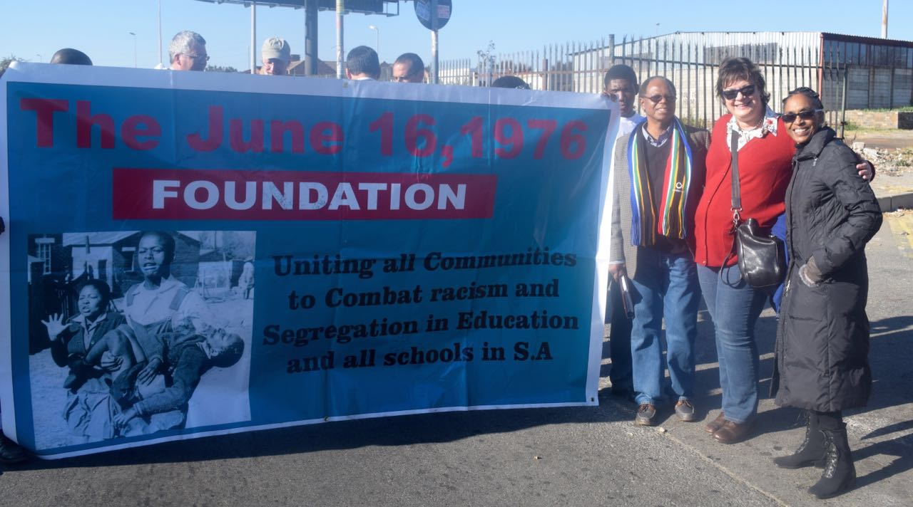
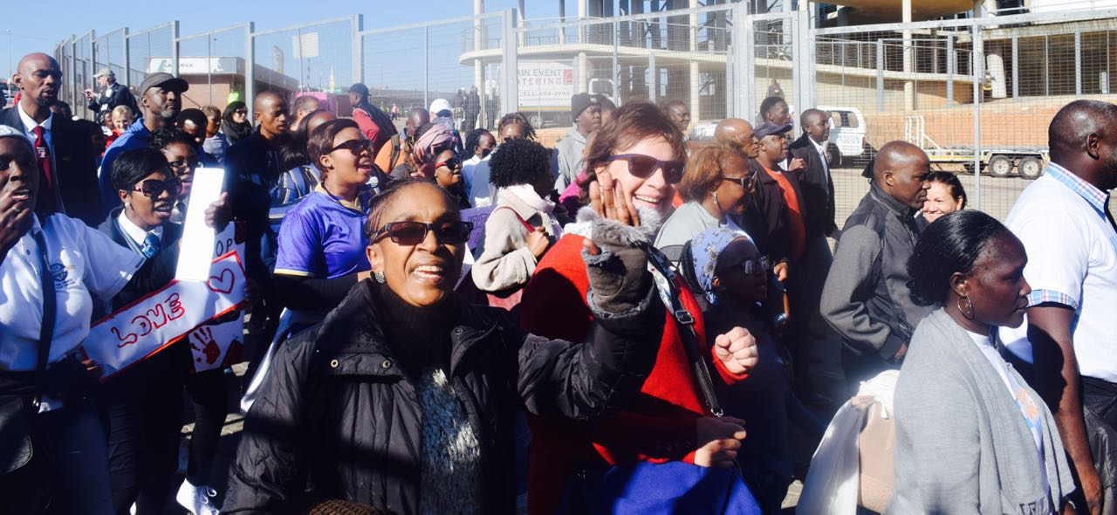
Connecting continued
Churches Reimagining 16 June 1976
Christians in a march of reconciliation on the 40th Anniversary of 16 June 1976

Slide 7
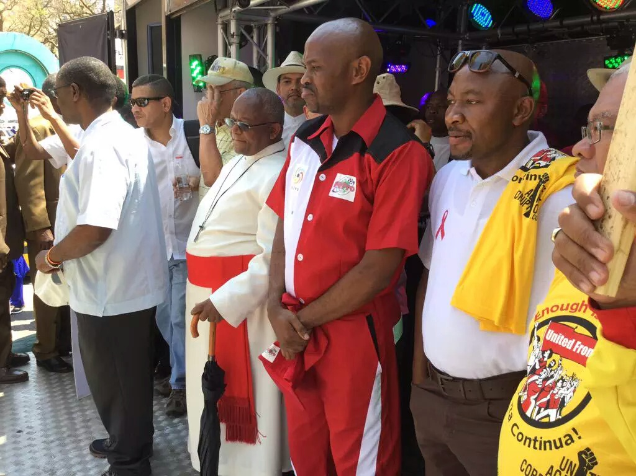
Connecting in alliances with
Civil society
Anti Corruption
Save South Africa
TEASA General Secretary addresses a Civil society public rally against Corruption.

Slide 8
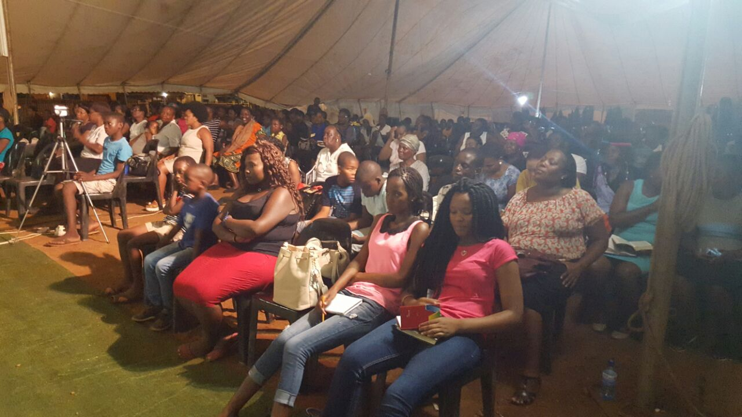
Capacitating churches
Strengthened the capacity of churches to do ministry effectively through:
Church planting& Discipleship Commission
Mission Commission.
Theology Commission
Health Commission
Women Commisssion

Slide 9
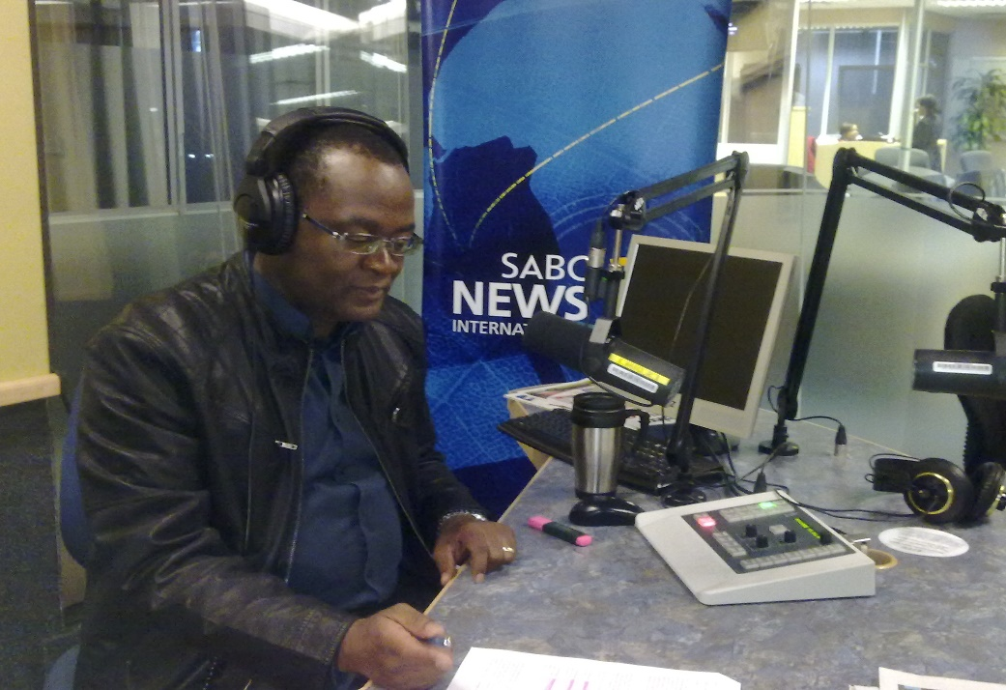
Communicating
Advocacy
Anti Corruption march
biblical values through the courts, parliament, media and other publics.
Evangelical voice increasingly heard and in the media, the ecumenical movement, the academy, government, political circles and civil society.

Slide 10

Ways you can be part of the growing TEASA witness today
TEASA Chapters
Commissions
Advocacy efforts
Conferences and events.
Praying for unity and mission
Donations

Slide 11
Thank You!
WWW teasa.org.za
info@ teasa.org
Teasa whatsapp: 0760901444

